Slide 1
Routing
Welcome, students!

Slide 2
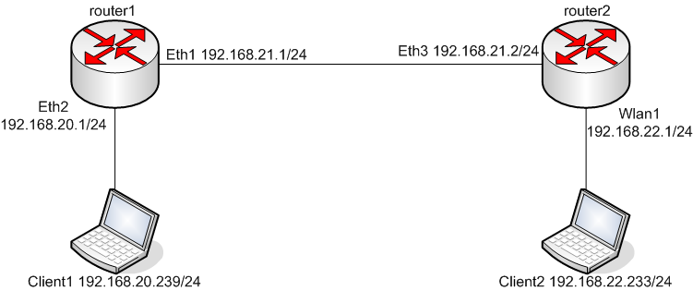
Intro
Routing refers to establishing the routes that data packets take on their way to a particular destination. Which is performed by layer 3 (or network layer) devices in order to deliver the packet by choosing an optimal path from one network to another.

Slide 3
To route, a router needs to know
Destination addresses
Sources it can learn from
Possible routes
Best route

Slide 4
Router Types
Static routing - network administrator configures information about remote networks manually. They are used to reduce overhead and for security.
Dynamic routing - information is learned from other routers, and routing protocols adjust routes automatically.
Because of the extra administrative requirements, static routing does not have the scalability of dynamic routing.

Slide 5

Types or Classes of Routing Protocols
Distance Vector
RIP V1
IGRP
RIP V2
Link state
OSPF
Hybrid
EIGRP

Slide 6
Thank You ALL

